Slide 1
C♯ Putting it all together
Rasmus Lystrøm
Associate Professor
ITU
rnie@itu.dk

Slide 2
Agenda
Security – authentication / authorization
ASP.NET Core Web API
Xamarin.Forms
DevOps – pipelines
Continuous Integration/Delivery/Deployment
Shift-left
Branching strategy vs. tactics
Infrastructure as Code
Trunk-based development

Slide 3
Security – ASP.NET Web API
(No Authentication)
(Invidual User Accounts)
Azure Active Directory B2C
Work or School Accounts (Azure Active Directory)
Windows Authentication (AD)
Azure App Service Authentication (easyauth.dll)

Slide 4
Security in ASP.NET Core Web API
Demo

Slide 5
Security in Xamarin.Forms
https://portal.azure.com/
Create new App Registration
https://azure.microsoft.com/en-us/resources/samples

Slide 6
Security in Xamarin.Forms
Demo

Slide 7

Azure DevOps

Slide 8
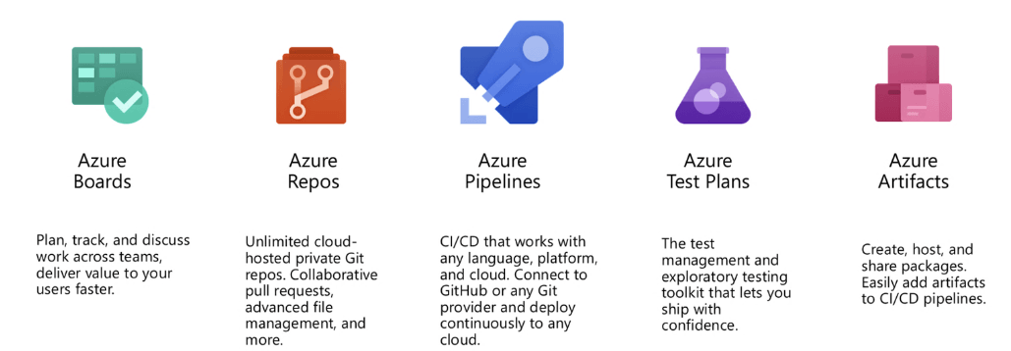
Azure DevOps

Slide 9
Azure DevOps
Demo

